Slide 1



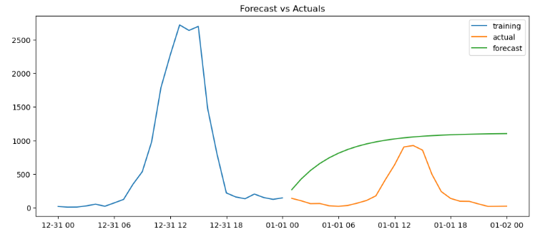
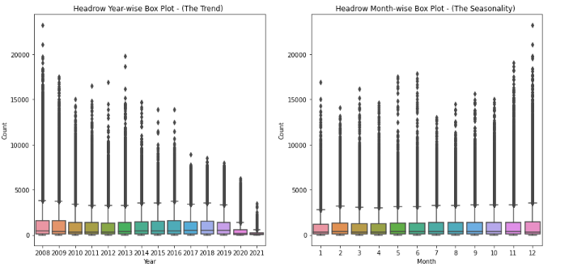
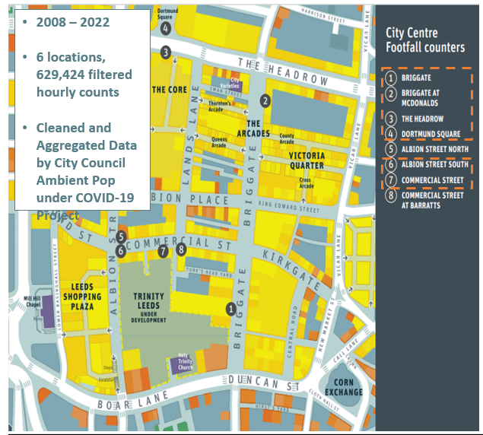
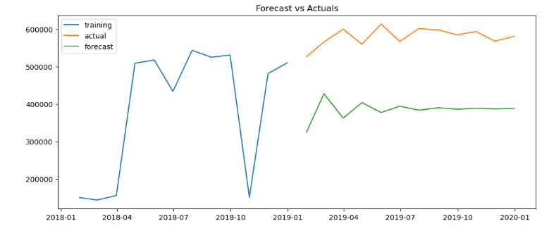

CDRC CORE THEME: Urban Analytics
Non covid hourly footfall counts
Modelling Ambient Populations under Different Restriction Schemes
Non covid hourly footfall counts
Non covid monthly
footfall
counts
Non covid monthly
footfall
counts
Plus 2 more…
Plus 2 more…
3 main stages:
i) TSA & visualisation (last update)
ii) ARIMA (SARIMA, exogenous etc.)
iii) Forecasting
Current:
i) 5 year staged model testing (2009 – 2019)
ii) Inclusion of exogenous variables
3 main stages:
i) TSA & visualisation (last update)
ii) ARIMA (SARIMA, exogenous etc.)
iii) Forecasting
So far:
i) ARIMA model (1,0,1) – hourly counts done
ii) ResCompLeedsCon2022
Indumini Ranatunga | Dr Patricia Ternes Dallagnollo | Dr Victoria Houlden | Dr Nicolas Malleson

